Slide 1
Digital Image Processing
Lecture 4:
Ch3:Image Enhancement in the Spatial Domain:
3:3 Histogram Processing
Dr. Hossam Mahmoud Moftah
Assistant professor – Faculty of computers and information –
Beni Suef University

Slide 2
Image Enhancement in the Spatial Domain: Histogram Processing
Histogram Equalization (Lab Assignment using python)
Histogram Matching
Local Histogram Processing (Lab Assignment using python)
Using Histogram Statistics for Image Enhancement

Slide 3
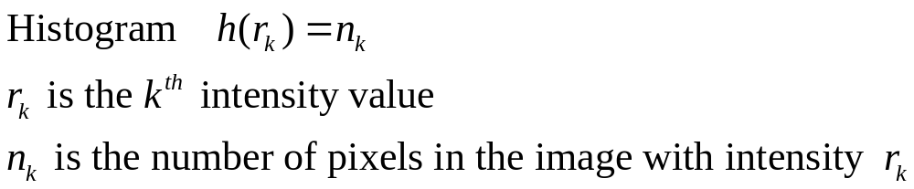
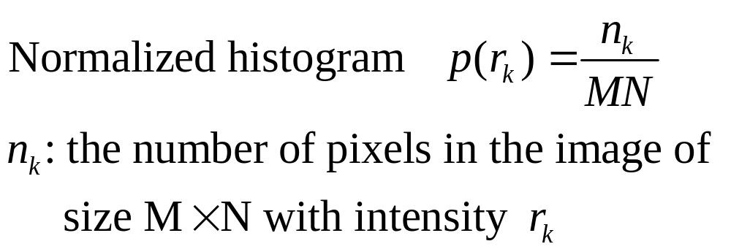
Histogram Processing

Slide 4
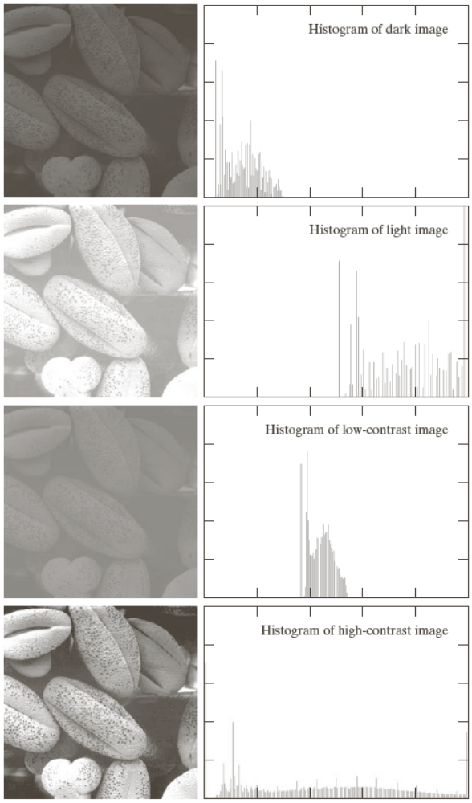

Slide 5
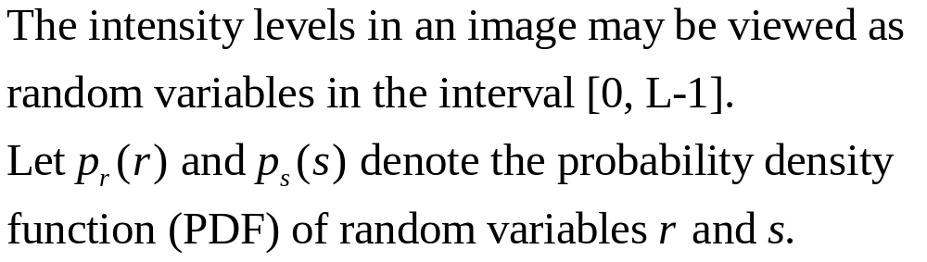
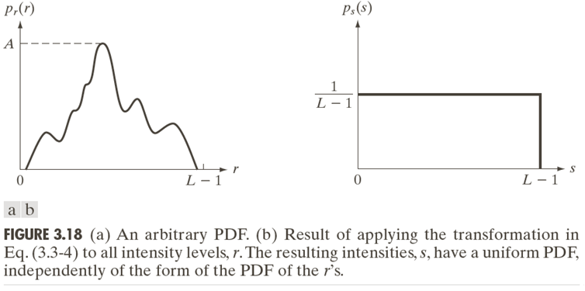
Histogram equalization

Slide 6

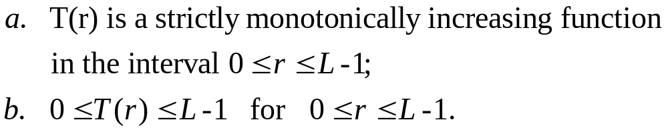
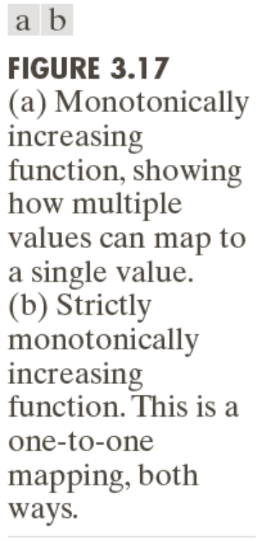
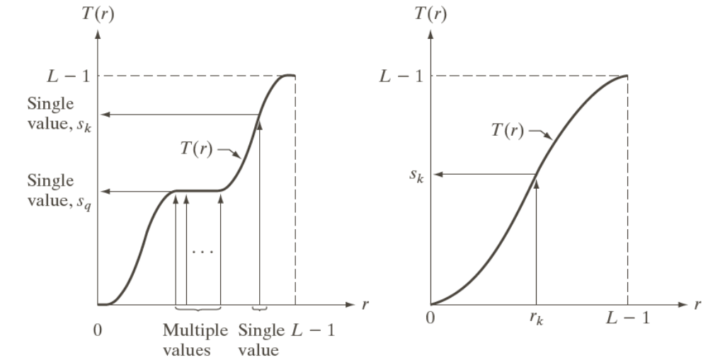
Histogram equalization

Slide 7
Histogram equalization

Slide 8
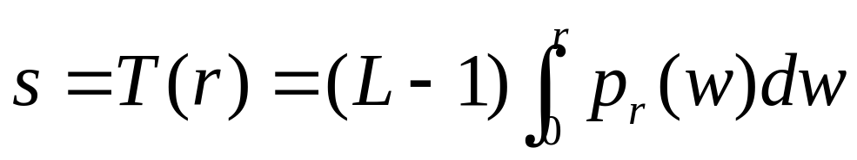
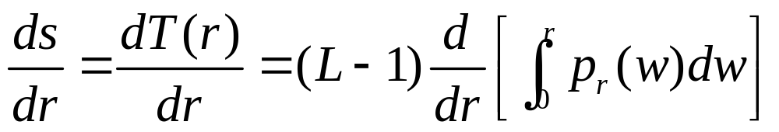
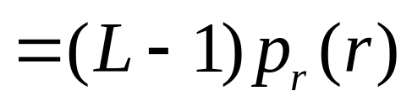
Histogram equalization

Slide 9
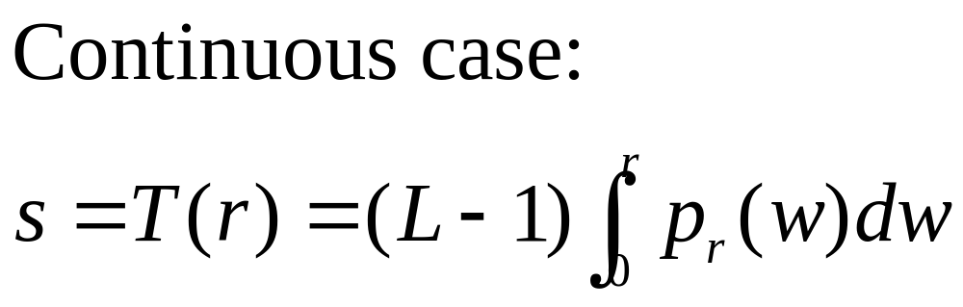
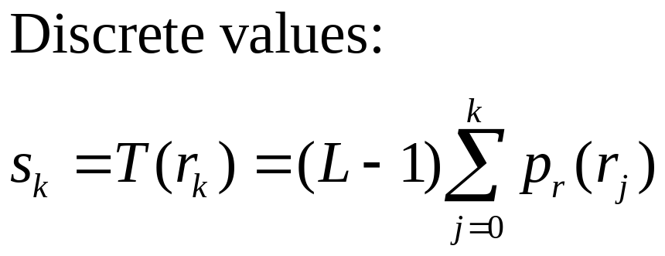
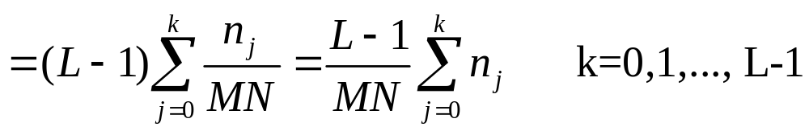
Histogram equalization

Slide 10
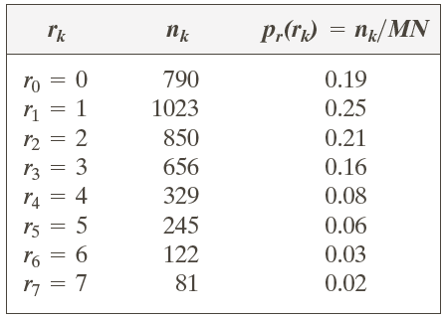
Example: Histogram equalization
Suppose that a 3-bit image (L=8) of size 64 × 64 pixels (MN = 4096) has the intensity distribution shown in following table.
Get the histogram equalization transformation function and give the p_{s}(s_{k}) for each s_{k}.

Slide 11
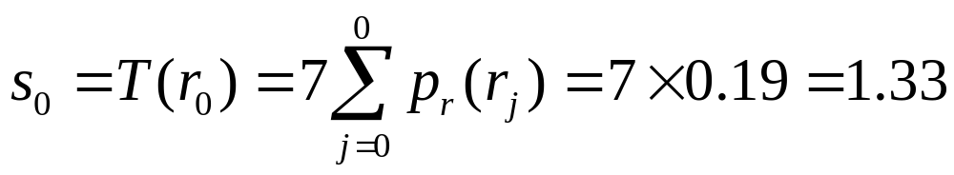
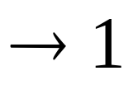
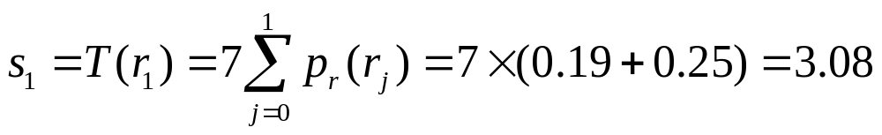

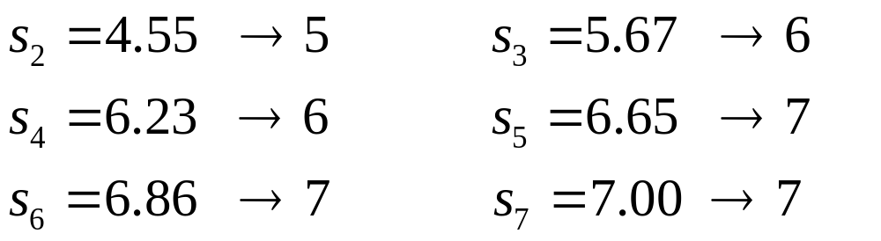
Example: Histogram equalization

Slide 12
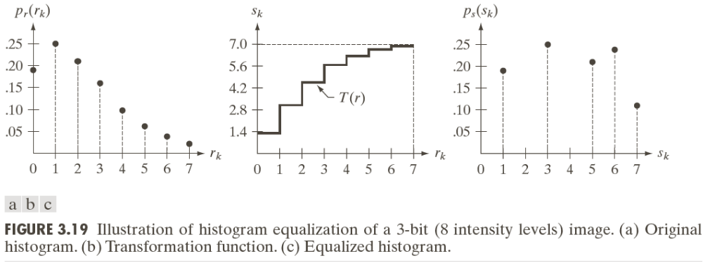
Example: Histogram equalization

Slide 13
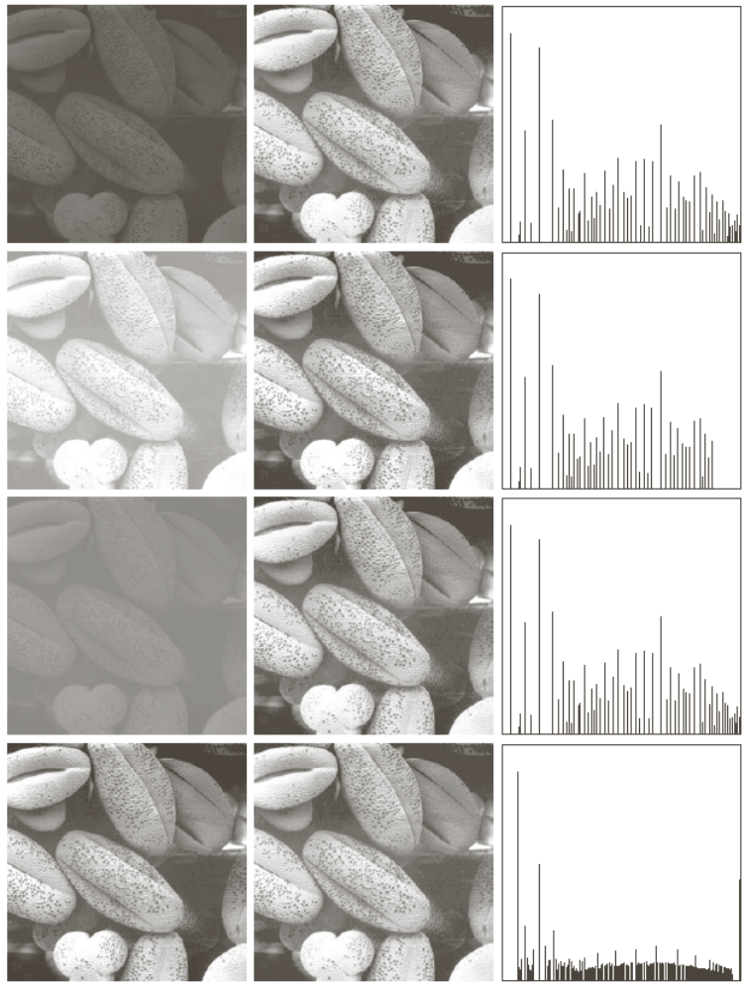

Slide 14
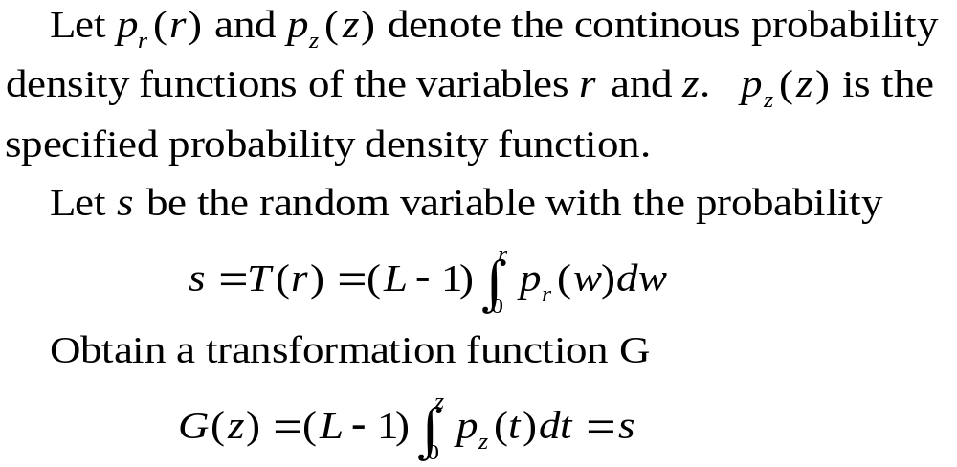
Histogram Matching
Histogram matching (histogram specification)
—A processed image has a specified histogram

Slide 15
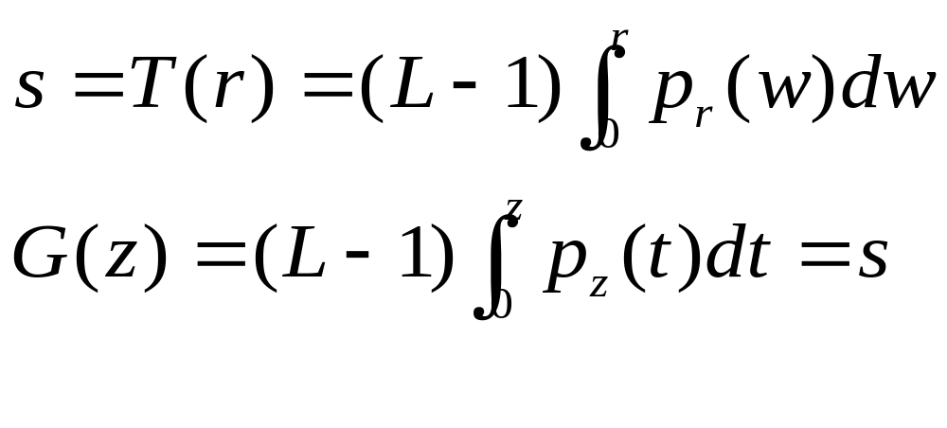
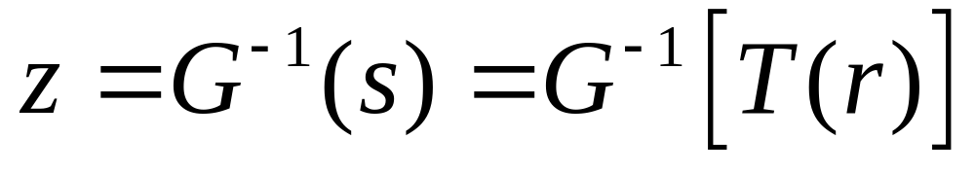
Histogram Matching

Slide 16
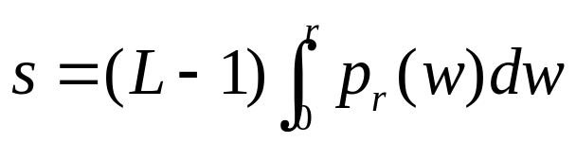
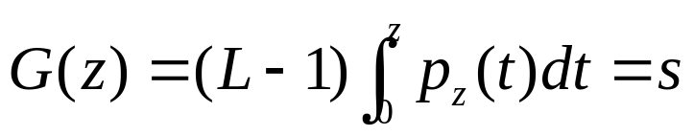
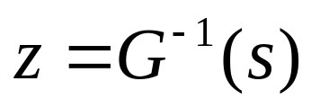
Histogram Matching: Procedure
Obtain p_{r}(r) from the input image and then obtain the values of s
Use the specified PDF and obtain the transformation function G(z)
Mapping from s to z

Slide 17
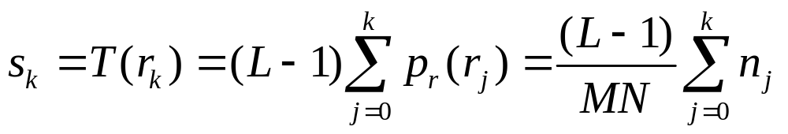
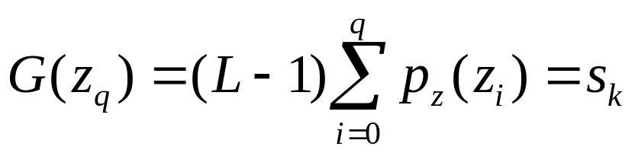
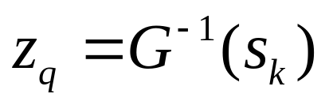
Histogram Matching: Discrete Cases
Obtain p_{r}(r_{j}) from the input image and then obtain the values of s_{k}, round the value to the integer range [0, L-1].
Use the specified PDF and obtain the transformation function G(z_{q}), round the value to the integer range [0, L-1].
Mapping from s_{k} to z_{q}

Slide 18
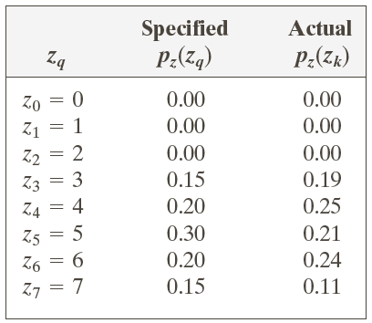
Example: Histogram Matching
Suppose that a 3-bit image (L=8) of size 64 × 64 pixels (MN = 4096) has the intensity distribution shown in the following table (on the left). Get the histogram transformation function and make the output image with the specified histogram, listed in the table on the right.

Slide 19
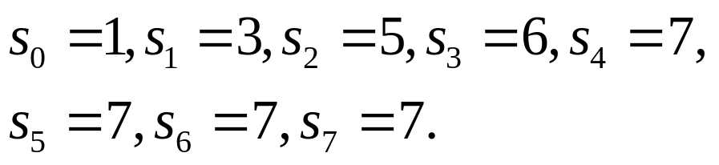
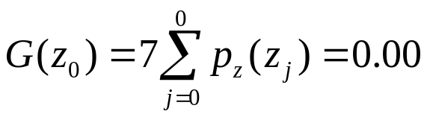


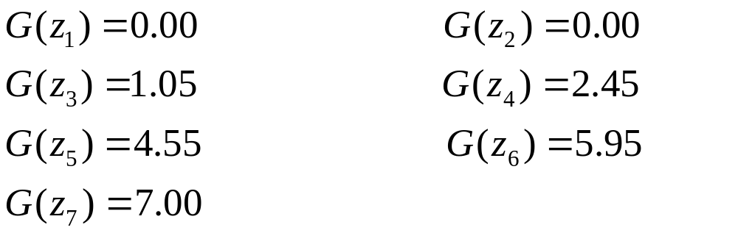






Example: Histogram Matching
Obtain the scaled histogram-equalized values,
Compute all the values of the transformation function G,

Slide 20
Example: Histogram Matching
Obtain the scaled histogram-equalized values,
Compute all the values of the transformation function G,
s₀
s₁
s₂
s₃
s₄
s₅
s₆
s₇

Slide 21
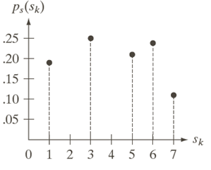
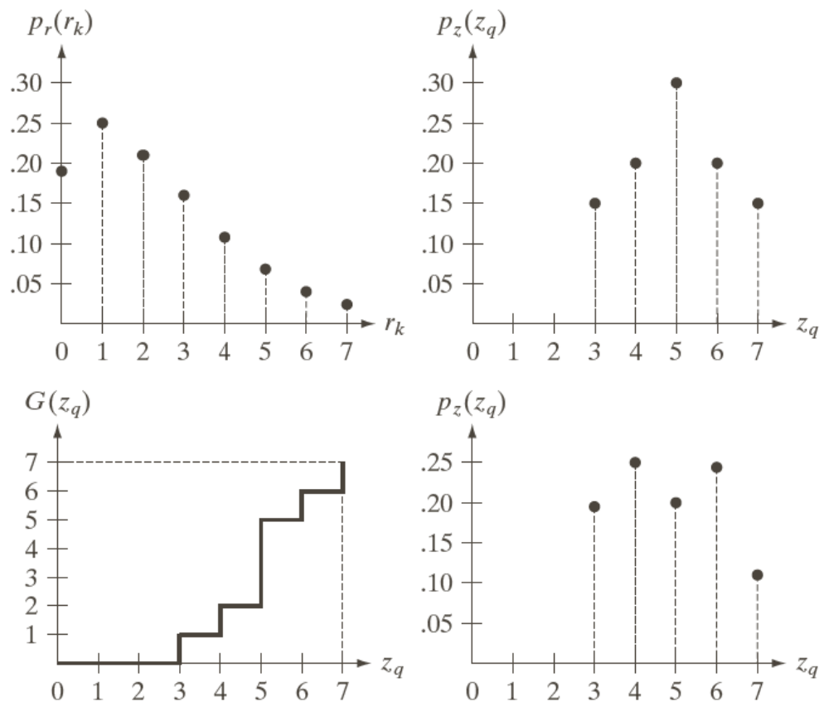
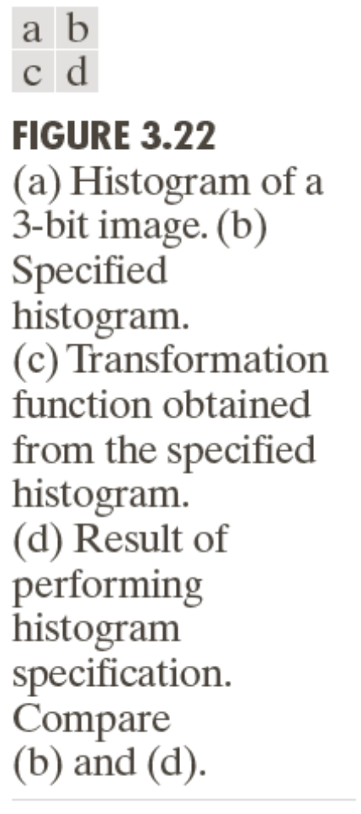
Example: Histogram Matching

Slide 22
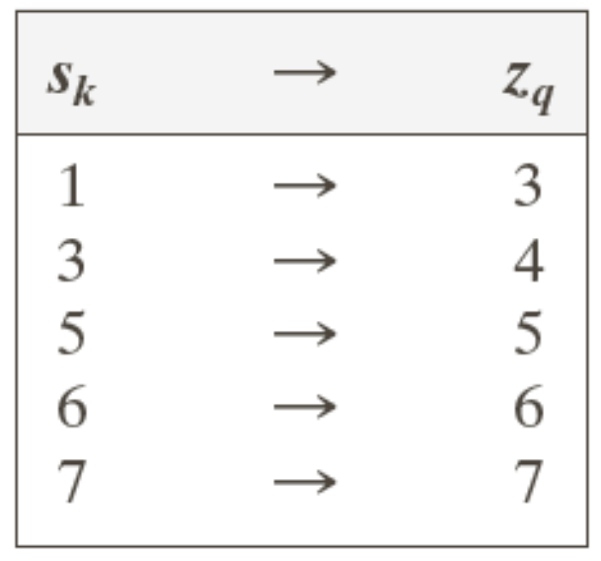
Example: Histogram Matching

Slide 23
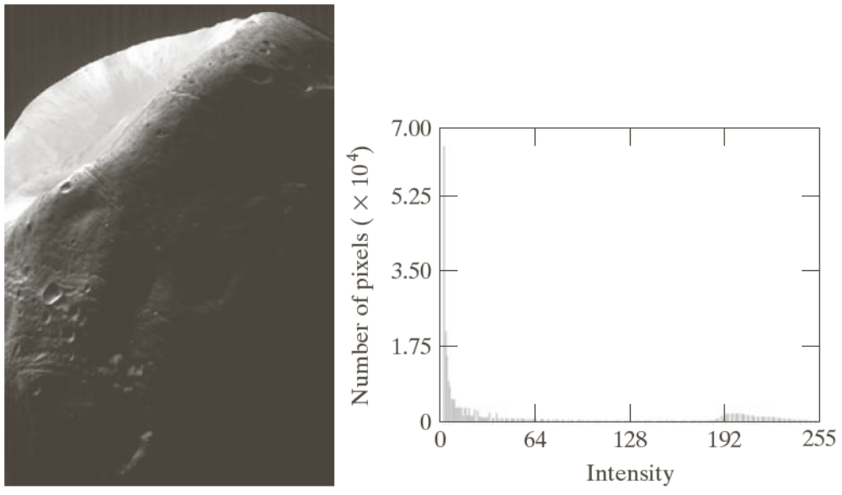
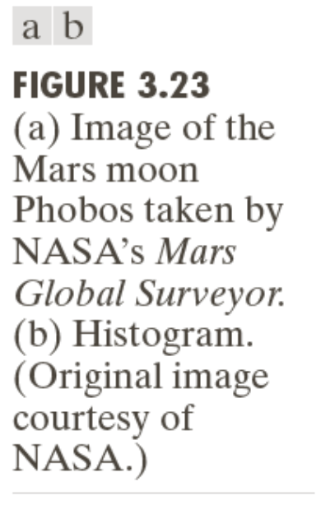
Example: Histogram Matching

Slide 24
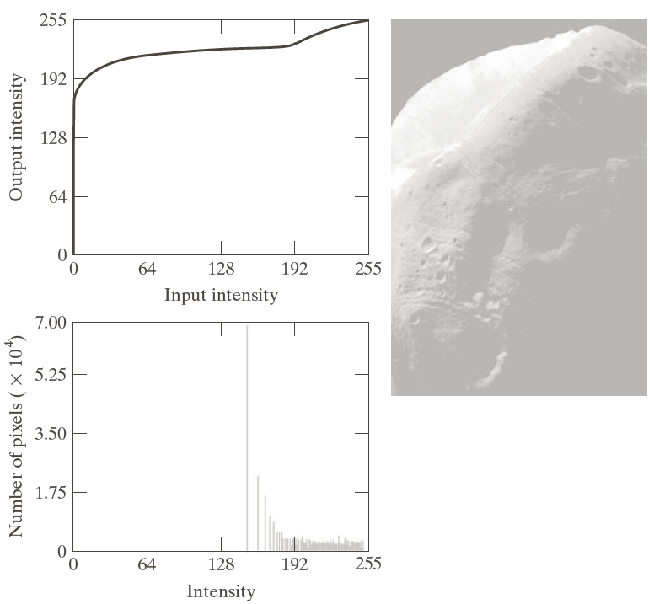
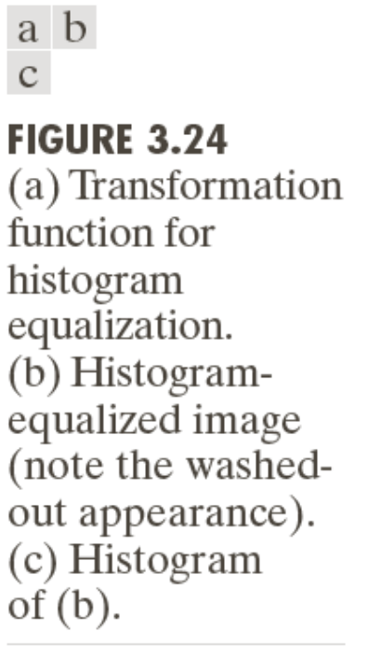
Example: Histogram Matching

Slide 25
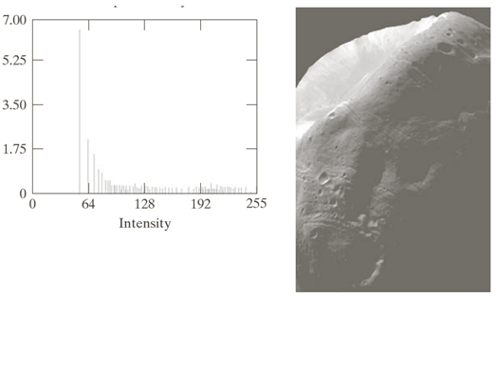
Example: Histogram Matching
Result of histogram specification

Slide 26
The end

